Slide 1
Bacteria, Protists, & Fungi

Slide 2
Bacteria

Slide 3
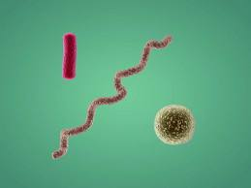
What are characteristics of all bacteria?
Unicellular
Prokaryotic
Some are producers, and others are consumers (decomposers)
Three basic shapes
Sphere shaped (cocci)
Rod-shaped (bacilli)
Spiral-shaped (spirilla)

Slide 4
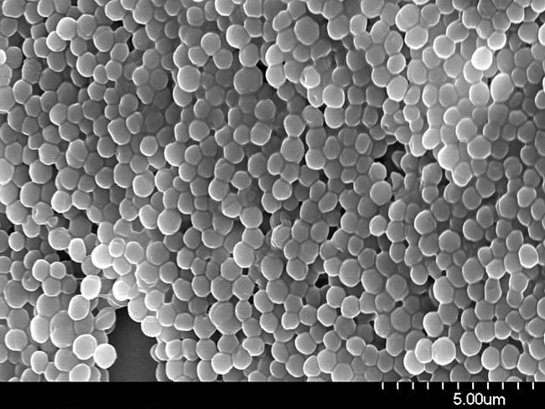
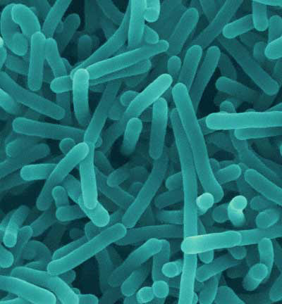
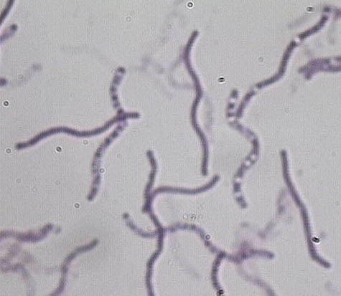
Picture of shapes

Slide 5
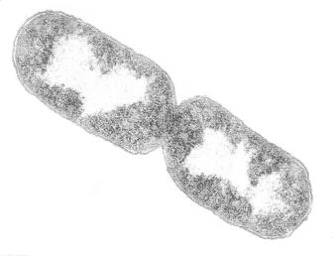
How do bacteria reproduce?
Asexually
Fission = a process that produces two new cells with genetic material identical to each other

Slide 6
What two kingdoms are made up of bacteria?
Archaebacteria
Live in extreme environments
Example: Anaerobe = bacteria adapted to live WITHOUT oxygen
Eubacteria
Live in everyday environments
Example: Aerobe: bacteria that requires oxygen to break down food

Slide 7
Protists

Slide 8
What are protists?
Usually found in wet or moist environments.
Most are unicellular organisms. Few are multicellular.
All are eukaryotic.
Can be divided into plant-like, fungus-like, and animal-like forms.

Slide 9
How are protists classified?
Based on how they obtain energy (autotroph or heterotroph)
If they have or do not have cell walls
If they can move around and how they move

Slide 10
What are animal-like protists?
Also known as protozoans
Cannot make their own food; instead capture other organisms and consume them for food
Do not have cell walls
Have specialized ways to MOVE FROM PLACE TO PLACE

Slide 11
How are protozoans classified?
By the ways they move from place to place
Ciliates: move by cilia (short, threadlike structures that extend from the cell membrane)
Flagellates: move by whipping their long flagella
Pseudopods: “false foot,” move by temporary extensions of their cytoplasm

Slide 12
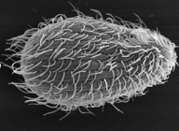
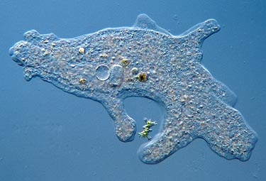
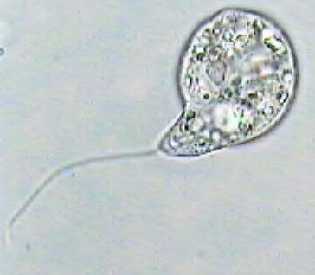

Slide 13
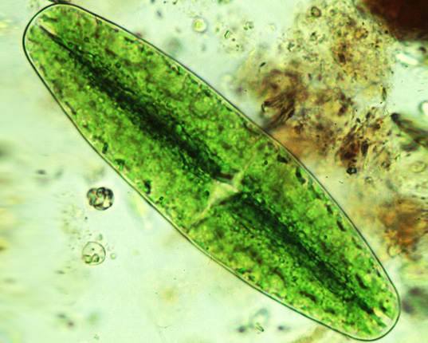
What are plant-like protist?
Also know as algae
Contain chlorophyll and make their own food using photosynthesis
Have cell walls
No specialized ways to
move from place to place

Slide 14
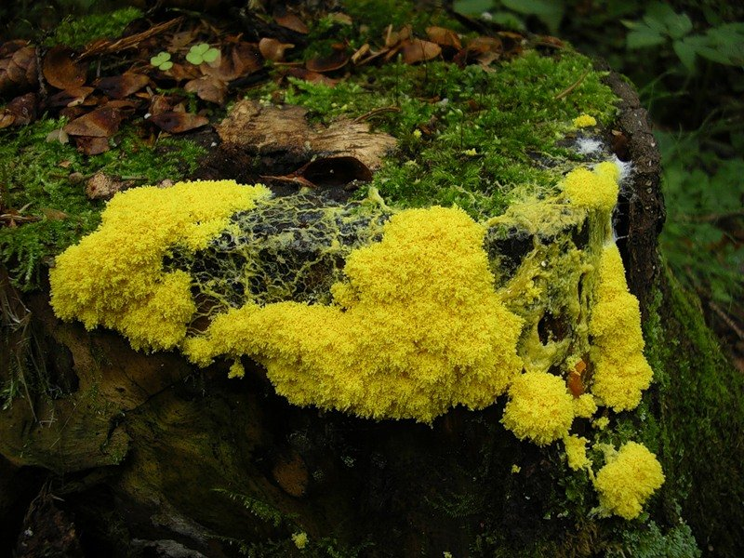
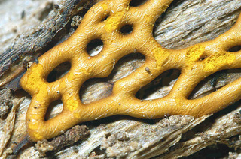
What are fungus-like protists?
Cannot make their own food; absorb food from their surroundings

